Slide 1

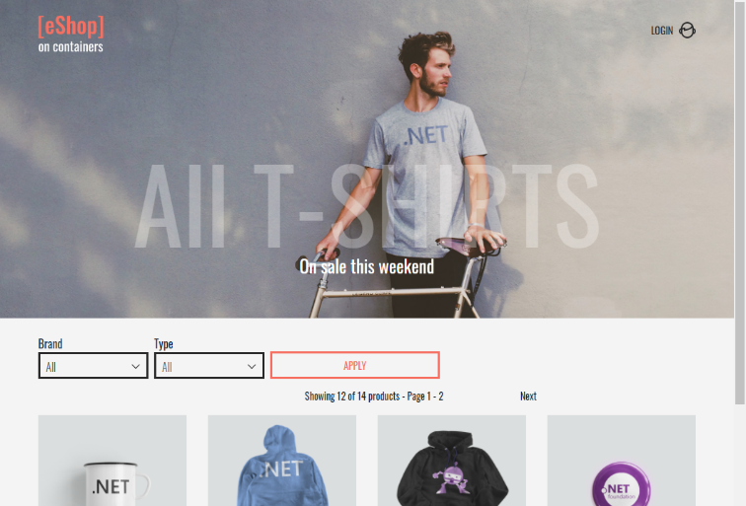
QA – Final Project
Orders Microservice by Ros Finkov
eShopOnContainers by Microsoft
https://github.com/dotnet-architecture/eShopOnContainers

Slide 2
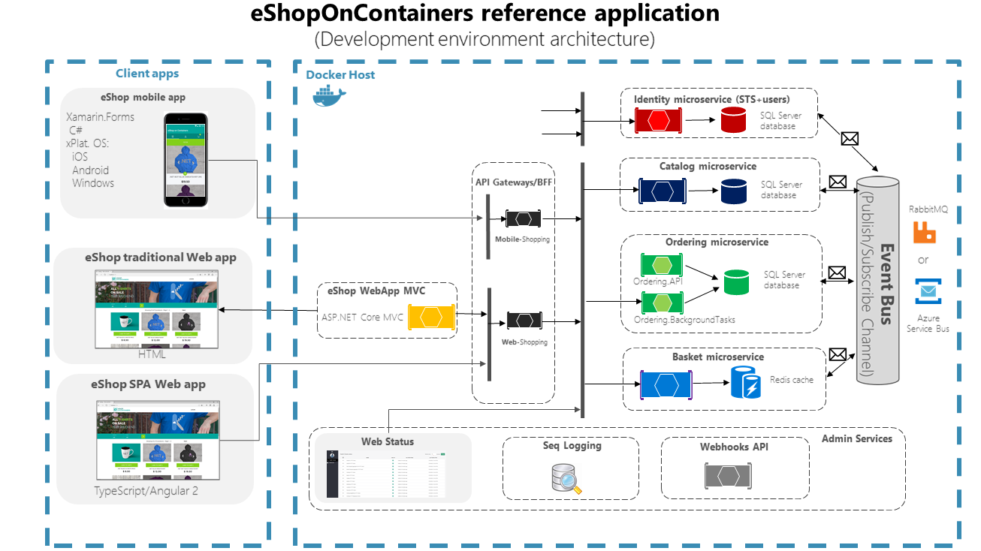
eShop Architecture

Slide 3







UUT - Unit Under Test
GUI
Ordering Service
Identity Microservice
SQL Server database
Catalog Microservice
Ordering Background Tasks
SQL Server database
SQL Server database
Basket Microservice
SQL Server database +n Redis
Ordering API
Payments Microservice
SQL Server database

Slide 4

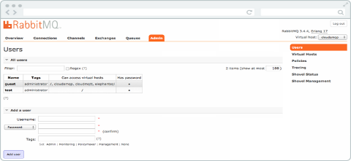


Environment
GUI
Ordering Service: Unit Under Test UUT
Miocroservices Simulator
Identity
Ordering Background Tasks
Payment
Catalog Simulator
SQL Server database
Basket
Catalog
Ordering API

Slide 5
Simulators
Catalog mock
Basket mock
Payment mock
ordering
ordering

Slide 6
System requirements
Orders Requirements
Order Management: The microservice should be able to manage the entire order process, including creating, updating, and canceling orders.
Order can be canceled only when it is in status submitted, awaitingvalidation or stockconfirmed)
Order Tracking: The microservice should provide online updates on the status of each order, including shipping information and delivery estimates.
Payment Processing: The microservice should integrate with a payment gateway to securely process payments from customers.
Inventory Management: The microservice should communicate with the inventory management system to ensure that products are available for purchase and to update inventory levels after an order has been placed.
Security: The microservice should implement robust security measures to protect customer data and prevent unauthorized access to sensitive information.
Scalability: The microservice should be designed to handle high volumes of at list 100 orders in one hour.
Reliability: The service can crash but when it is restarted it should continue from the point where it crashed

Slide 7
1. Order Management
The microservice should be able to manage the entire order process, including creating, updating, and canceling orders.
Test cases:
Create Order success scenario, mss.
Create Order with out-of-stock items.
Create Order with failed payment.
Canceling an order from status Submitted
Canceling an order from status Awaitingvalidation
Canceling an order from status Stockconfirmed.
Canceling an order from status Paid.
Canceling an order from status Shipped.
Update order from status Submitted.
Update order from status Awaitingvalidation.
Update order from status Stockconfirmed.
Update order from status Paid.
Update order from status Shipped.
Update order from status Cancelled.

Slide 8
2. Order Tracking
The microservice should provide online updates on the status of each order, including shipping information and delivery estimates.
Test case:
create order and items in stock .
Update check successfully 4 to 5
Mss - Create new order success flow.

Slide 9
3. Payment Processing
The microservice should integrate with a payment gateway to securely process payments from customers.
Test case:
Check creation of order payment failed.
Mss - Create new order success flow.

Slide 10
4. Inventory Management:
The microservice should communicate with the inventory management system to ensure that products are available for purchase and to update inventory levels after an order has been placed.
Test case:
Create new order with an out-of-stock quantity.
Mss - Create new order success flow.

Slide 11
5. Security
The microservice should implement robust security measures to protect customer data and prevent unauthorized access to sensitive information.
Test case:
Security - get order of another user
Security - cancel order of another user
Security - change status order of another user
Security - without identification

Slide 12
6. Scalability
Scalability: The microservice should be designed to handle high volumes of at list 100 orders in one hour.
Test case:
Scalability - checking 100 order per hour

Slide 13
7. Reliability
Reliability: The service can crash but when it is restarted it should continue from the point where it crashed
Test case:
Reliability - Service Continues from Crash Point. 0 to 5
2. Reliability - checking 100 order per hour performance

Slide 14
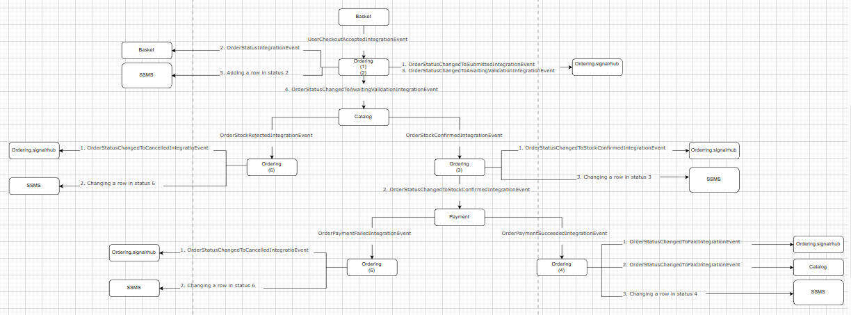
Ordering Service message flow

Slide 15
Test case - MSS
Functional testing
Test 1: Create Order success scenario, mss
Name: Ros Finkov
Requirement: Order Management
Preconditions: microservice Ordering, Identity running and connected to the required RabbitMQ queues, database is set up with the required tables and entities.
Basket, Catalog and Payment microservices are Simulated.
Ordering-Background service is down.
Test group: Sanity, Functional
 | Test steps | Expected result
1 | Send Basket simulator message to RabbitMQ-> queue: Ordering -> Routing key: UserCheckoutAcceptedIntegrationEvent | A new order entity was created with OrderStatusID =1 in DB in order remove items form basket, ordering service send a message to RabbitMQ-> queue: Basket -> Routing key: OrderStartedIntegrationEvent
2 | Turn On Ordering-Backgroudtasks service. | Order entity updated Set OrderStatusID =2 in DB To verify that item in stock, a message sent to RabbitMQ-> queue: Catalog -> Routing key: OrderStatusChangedToAwaitingValidationIntegrationEvent
3 | Send Catalog simulator message to RabbitMQ-> queue: Ordering -> Routing key: OrderStockConfirmedIntegrationEvent | Order entity updated Set OrderStatusID = 3 in DB In Order Create payment, Ordering sends a message to RabbitMQ-> queue: Payment -> Routing key: OrderStatusChangedToStockConfirmedIntegrationEvent
4 | Send Payment simulator message to RabbitMQ-> queue: Ordering-> Routing key: OrderPaymentSucceededIntegrationEvent | Order entity updated Set OrderStatusID =4 in DB and process is done here
ID | Status Name
1 | Submitted
2 | Awaitingvalidation
3 | Stockconfirmed
4 | Paid
5 | Shipped
6 | Cancelled

Slide 16
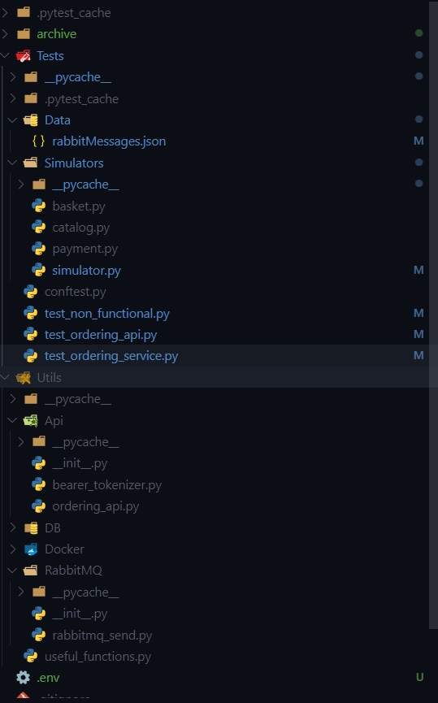
The project architecture

Slide 17
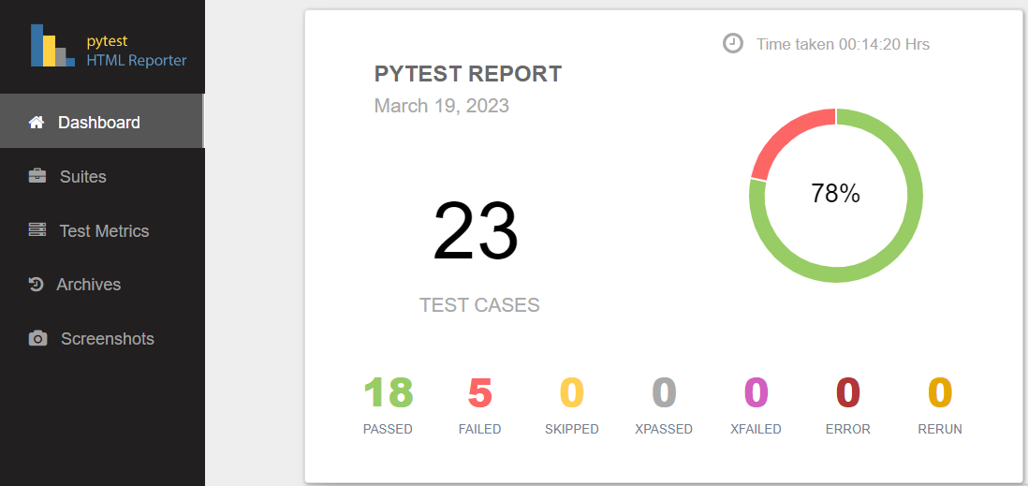
Pytest report

Slide 18
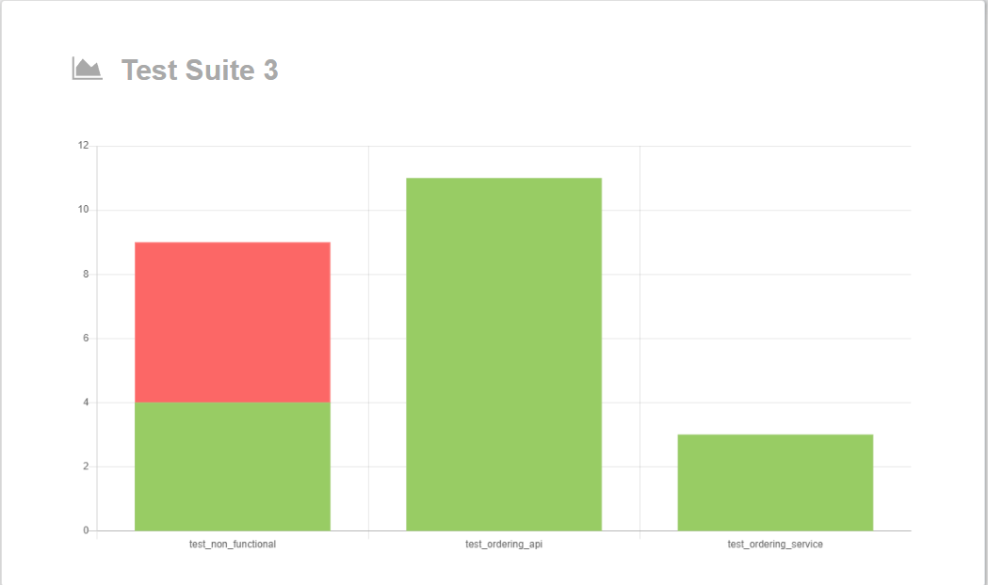
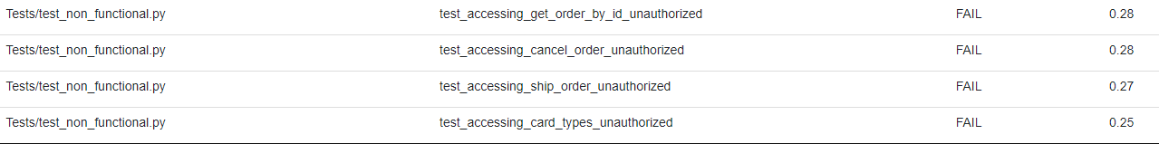

Slide 19
Link to GitHub:
https://github.com/nirarad/rafael-ness-bootcamp/tree/RosFinkov

Slide 20
Thanks for listening

